Slide 1
Adv WPF Workshop
Houston Open Spaces
4/30/2010

Slide 2
Who the hell are you?!
Jonathan Birkholz -> JB
Blog – www.theabsentmindedcoder.com
@RookieOne
GitHub – http://github.com/rookieone

Slide 3

Geek Factor
Claudio skateboards, plays guitar, rollerblades!
I play video games, read science fiction, and enjoy playoff hockey
Raptr.com/rookieone
www.goodreads.com/user/show/3300815-jonathan-birkholz

Slide 4
Purpose
Teach you something new
Rethink something you thought you knew
Have you examine how you see and work with Xaml

Slide 5

Demo Time!
When we see this
It means there it is time to jump into code

Slide 6
Advanced?
Do I need to know WPF? – No
Can I follow along? – Yes
When can I ask questions? – Anytime
If someone can write a book on LINQ, then I can call this workshop advanced - JB

Slide 7
Where do we start?

Slide 8
Revisit dependencies

Slide 9
What is a Dependency Object?
The base class for any object that can support dependency properties. – WPF Unleashed

Slide 10
Object
Dispatcher Object
Dependency Object
Freezable
Visual
ContentElement
UIElement
FrameworkElement
Control
FrameworkContentElement

Slide 11
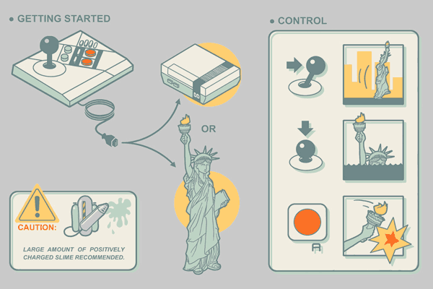
Dependency Properties
Magic goo of WPF
Enables:
Styles
Trigger
Animations
Binding

Slide 12
Dependency?
A dependency property depends on multiple providers for determining its value at any point in time – WPF Unleashed
Determine Base Value
Evaluate
Apply Animations
Coerce
Validate

Slide 13

DPs are our friends

Slide 14
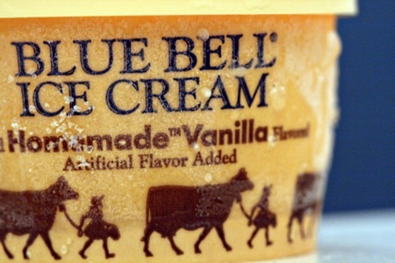
Vanilla Flavored DOs + DPs
GetValue
SetValue
As Property
In Xaml

Slide 15
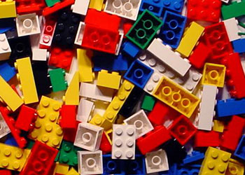
Create Your Own
Inherit Dependency Object
Have static property
Register Property
Set Property Type
Set Owner Type

Slide 16

Attached DPs
An attached property is a special form of dependency property that can effectively be attached to arbitrary objects – WPF Unleashed

Slide 17
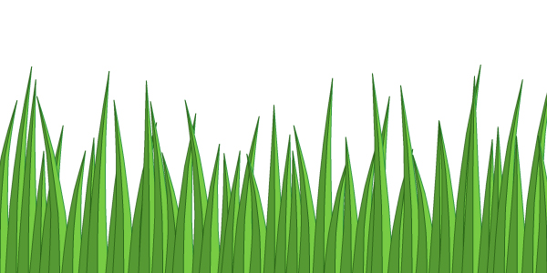
In the ‘wild’
Grid.Row
Canvas.Left
DockPanel.Dock
ScrollViewer.CanContentScroll
TextElement.FontSize

Slide 18

Exploring Attached DPs
Setting
Getting
Creating our own
Register Attached
Static Get
Static Set

Slide 19
Remember this step?
Determine Base Value
Local value
Style Triggers
Template Triggers
Style setters
Theme style triggers
Theme style setters
Property value inheritance
Default value
Precedence

Slide 20
Default Value
No matter what DP and DO, if you ask for the value of a DP on a DO that doesn’t already have a value set, you will get the default value

Slide 21
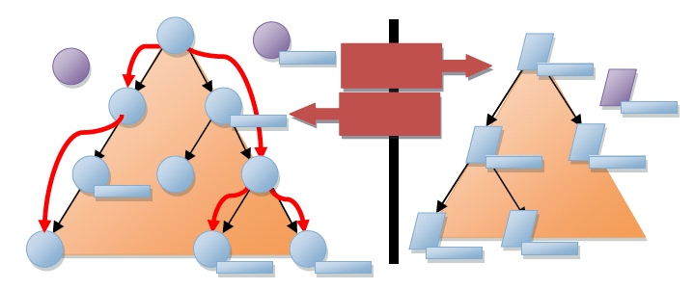
Inheritance
Refers to the flowing of property values down the element tree

Slide 22
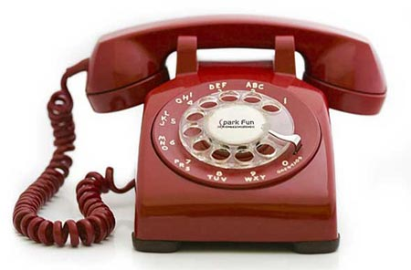
PropertyChanged CallBack
Specify a callback method when the property is changed / this is also called when set

Slide 23
Behaviors
Leverage the PropertyChanged CallBack to attached additional functionality
Attached Dependency Property
Set CallBack
PROFIT

Slide 24


Blend Behaviors
Similar concept to Behaviors but with the power of BLEND
Integrated into Blend
And lemon scented….

Slide 25

Styles, templates, and skins oh my

Slide 26
Style
Sets Dependency Property Values
Reread that first line
Not just colors and font sizes
ALL Dependency Properties!

Slide 27
DRY
Don’t Repeat Yourself
Styles allow sharing the setting of values with multiple entities
TargetType
Sets scope of properties
And scope of application of style

Slide 28

Style Gotchas
Last setter wins!
Don’t need case A and case B triggers
Implicit Styles actually have keys

Slide 29
Template
Allows you to completey replace an element’s visual tree with anything you can dream up, while keeping all its functionality intact – WPF Unleashed
Provides the “Look” to “Look-less” controls
Control - Logic
Presentation - Template
UI

Slide 30
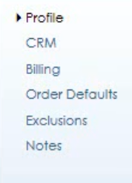
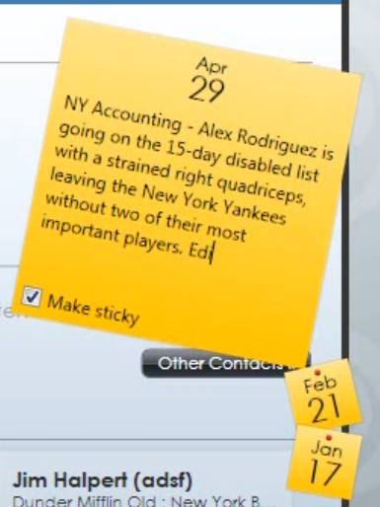

Templates in Action
List Box
Tab Control
Buttons

Slide 31
Hierarchy Revisited
Visual
provides for building a tree of visual objects
UIElement
defines core subsystems including Layout, Input, and Events
Framework Element
builds on the basic layout contract introduced by UIElement and adds the notion of a layout "slot”
Control
Adds the templating feature

Slide 32

Named Parts
PART_XXX
Some controls look for named controls in their template and add additional functionality

Slide 33
Style + Template
In Style set Template
This leads to a confusion on what the difference is between a Style and a Template

Slide 34

Resources + Dictionaries
Move styles to resources
Move resources to resource dictionaries
App.xaml
Merged Dictionaries

Slide 35

Anything can be a resource
Style
Template
Converter
Object
Anything…

Slide 36

Static vs Dynamic
Static – applied only once
Dynamic – reapplied every time it changes

Slide 37

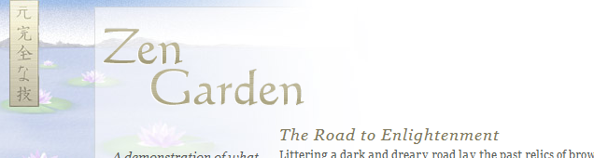

Skinning
Leverage the swapping ability of dynamic resources to be able to change the look of an application

Slide 38

Load from File
Load Resource Dictionary from file
Use File watch on directory with dynamic refresh

Slide 39

Resource Dictionary Loader
Load Resource Dictionary from Assemblies

Slide 40
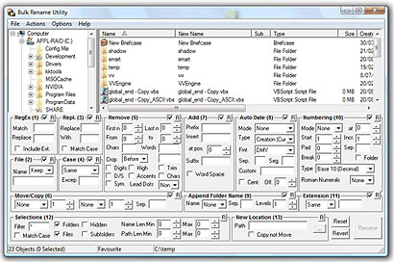

Help! I’m not a designer!

Slide 41
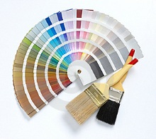
Colors + Brushes
Anything is a resource?
Colors!
Brushes!

Slide 42
Markup Extensions
Enable you to extend the expressibility of XAML
Examples
{x:Null }
{Binding …}
{StaticResource }
{DynamicResource }

Slide 43
Custom Markup Extension
Inherit MarkupExtension
Object name include MarkupExtension
Override abstract method
Inverse Color
Lighten Color

Slide 44
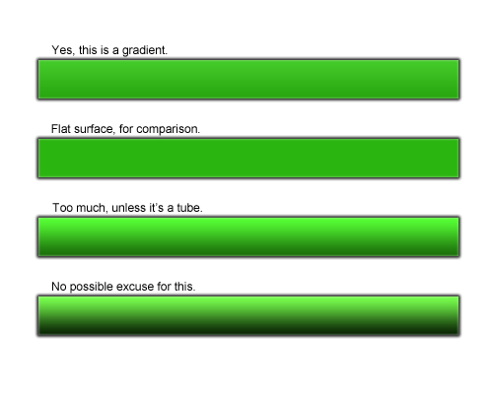
Gradients
So awesome yet so easy to screw up

Slide 45
Fonts
Fonts as resource
Open Source fonts
http://ingebretsen.posterous.com/10-favorite-open-source-fonts-you-can-embed-i
Embed Font

Slide 46
Bitmap Effects
Renders in software
Since in software -> poor performance
When applied to parent, it applies effect on all children
FAIL

Slide 47
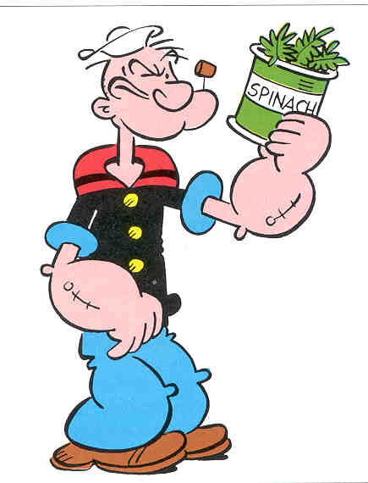
Effects
Uses Graphic Card therefore super fast and awesome
Drop Shadow
Drop Shadow -> Glow
Effects as resources

Slide 48

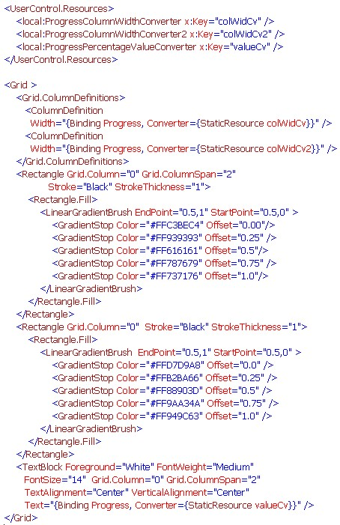
Semantic xaml

Slide 49
UIX

Slide 50

Tech is the answer!
Binding!
Styles!
Gradients!
Effects!
Animations!
Blend!

Slide 51

Still Fail

Slide 52
More to UIX than tech
Designer and Developer workflow is still broken
UI Work is
Expensive
Time consuming
Painful

Slide 53
Why?
WPF and XAML is not designer friendly
Designers know colors and fonts but not tech of WPF
Developers know tech of WPF but nothing about colors and fonts

Slide 54
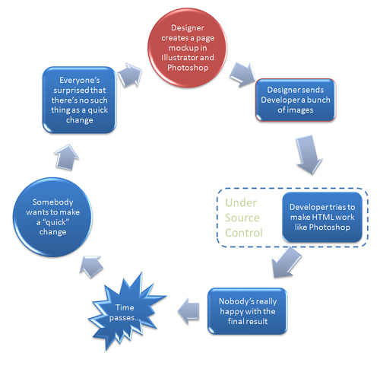
Specialists Gap

Slide 55
Blend
No Visual Editor will help (relate to web)
Do web designers use Dreamweaver?
“The good ones don’t”
No editor has adequately solved the problem of converting what the designer sees into meaningful markup

Slide 56
Blendability
“You can’t do that because it doesn’t work in Blend”
The ability of a M-V-VM or an application to be open in Blend
Ward Bell : Of Tailors and Tooling

Slide 57

Devigners
See the xaml
Bridge the gap
Know WPF’s tech capabilities to facilitate creating better UI + design workflow
See the design

Slide 58

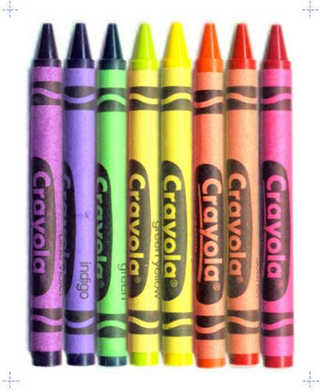
WPF vs Winform
Anything you can do I can do better

Slide 59

Change
Reconsider old fashioned ideas
Don’t think drag and drop
You must unlearn what you have learned - Yoda

Slide 60
WPF Truth
XAML
Code

Slide 61
Clean Xaml
We get upset if our classes are heavily nested and over 1k lines long but have no issue with our xaml files?
Adding nested elements increases the likelihood of errors creeping in during design

Slide 62
Visual Editor = Code Gen
We should have the same hesitation over using a visual editor as we do using code generation.
All xaml is code
All visual editors generate xaml
Then all visual editors generate code

Slide 63
ML = Markup Language
If XAML is a markup, what other markup language do we know of?
HTML!
We should learn from the web
The web has YEARS of UI markup experience

Slide 64
Semantics
In markup, semantics is concerned with the meaning of an element and how that element describes that content it contains
– Molly Holzschlag

Slide 65
Why Semantics
Meaningful markup and structure simplifies design
Reduces time to create views
Reduces time to mentally deconstruct a doc
Reduce margins and costs of errors
Simplifies the understanding of markup written by another developer

Slide 66
Naming
Names should relate to context and not appearance
Setup semantic naming conventions for teams
Large Font Label
Section Title

Slide 67
Breakdown apps

Slide 68
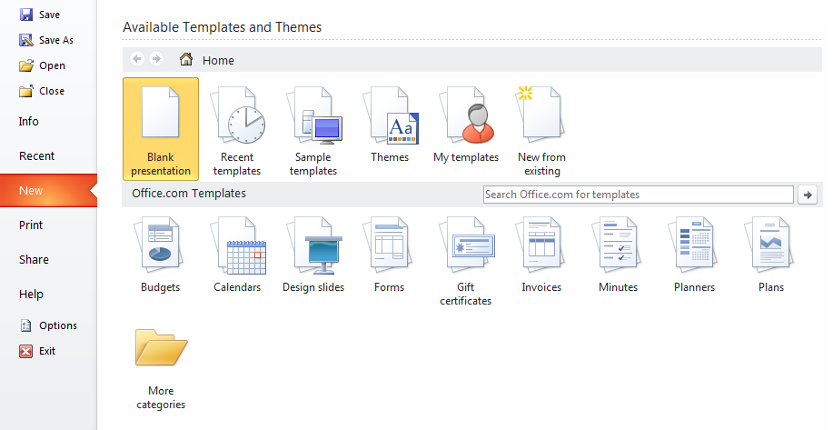

Slide 69
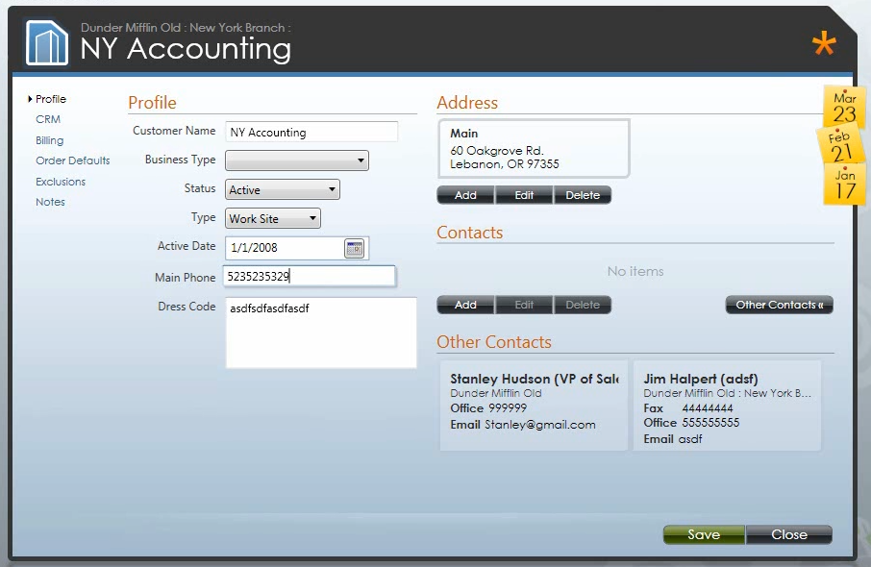

Slide 70
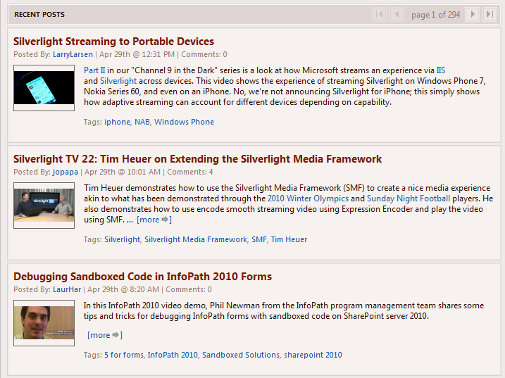

Slide 71
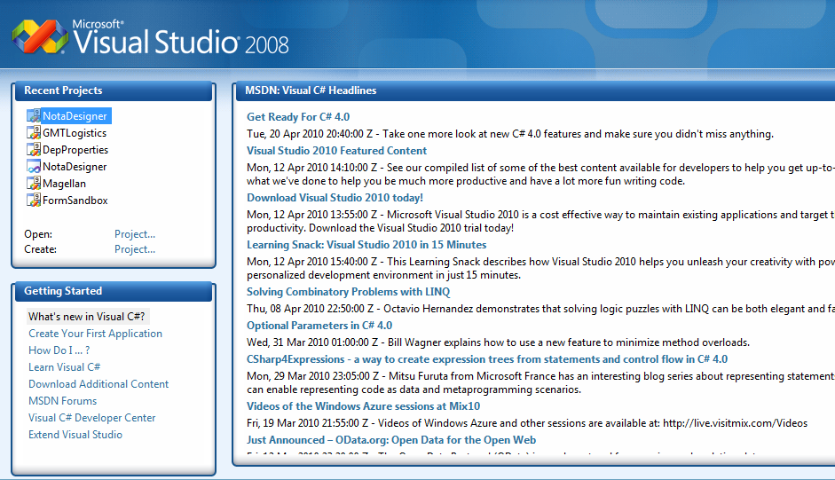

Slide 72
Custom Controls
Declare semantic controls
Allows setting styles by target type
No preconceived ideas on template implementation
Label template that uses a Listbox would be confusing
Section Title example

Slide 73
Presentation & Structure
I committed the hangable offense of mixing structure with presentation – David Siegel

Slide 74
Separation of Concerns
UI Interaction and logic
Structure and presentation
Focus on content and not presentation
Brings back to editors suck!
Great layout panels and then you just drag and drop fixed margins into a grid? WTF!?

Slide 75
Displaying Buttons
Instead of displaying a stackpanel with a collection of buttons, lets display an actions control with a collection of actions

Slide 76
Form
Why can’t we have a control that figures out what fields to display?!
Let’s do it

Slide 77
Rethink grids

Slide 78
Grids are inadequate
Grids represent data
But everything isn’t data
Destroy some myths

Slide 79
All the world is a list

Slide 80
Data Templates
Using Keys
Using DataType

Slide 81
Item Container Style
Style item
Selected Style

Slide 82
Items Panel
Sets the panel to use to host the items
IsItemsHost
VirtualizedStackPanel
Tab Control
Animated StackPanel

Slide 83
Reference
Ward Bell : Of Tailors and Tooling
http://neverindoubtnet.blogspot.com/2010/03/of-tailors-and-tooling-rant.html
Herding Code : Scott Bellware on HTML Specialists
http://herdingcode.com/?p=232

